Slide 1


AWS Cognito Kole Vasilevski, Principal Software Engineer

Slide 2
Cognito
A user management and authentication service that can be integrated to your web or mobile applications.
Amazon Cognito also enables you to authenticate users through an external identity provider, SAML or OpenID Connect, social identity providers (Facebook, Twitter, Amazon, Google, Apple)
Provides temporary security credentials to access your app’s backend resources in AWS or any service behind Amazon API Gateway.
Amazon Cognito uses JSON Web Tokens for token authentication.
Amazon Cognito consists of: User Pools and Identity Pools

Slide 3
Cognito User Pools
User pools are user directories that provide sign-up and sign-in options for your app users.
Users can sign into your web or mobile app through Amazon Cognito (act as Identity Provider) or federate through a third-party identity provider –IdP (act as identity Broker).
You can use the aliasing feature to enable your users to sign up or sign in with an email address and a password or a phone number and a password.
User pools are each created in one AWS Region, and they store the user profile data only in that region
Manage users

Slide 4
Cognito Identity Pools
Use this feature if you want to federate users to your AWS services.
Identity pools enable you to grant your users temporary AWS credentials to access AWS services, such as Amazon S3 and DynamoDB.
Identity pools support anonymous guest users, as well as the following identity providers:
Amazon Cognito user pools
Social sign-in with Facebook, Google, and Login with Amazon
OpenID Connect (OIDC) providers
SAML identity providers
Developer authenticated identities

Slide 5
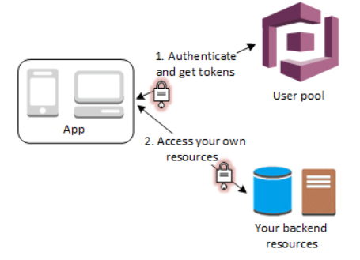
Cognito Use Case Acting SSO

Slide 6
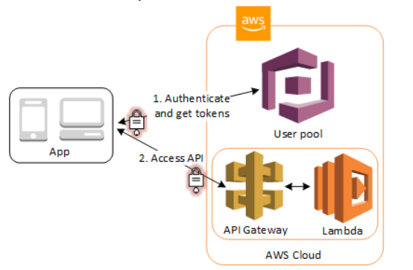
Cognito Use Case Acting SSO

Slide 7
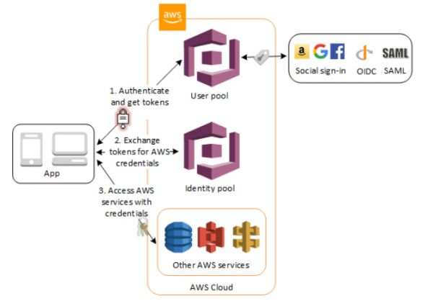
Cognito Use Case User access to AWS services through an identity pool

Slide 8
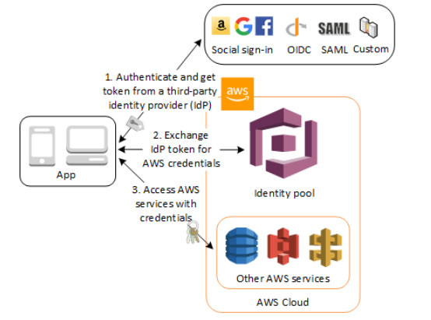
Cognito Use Case User access to AWS services through an identity pool

Slide 9
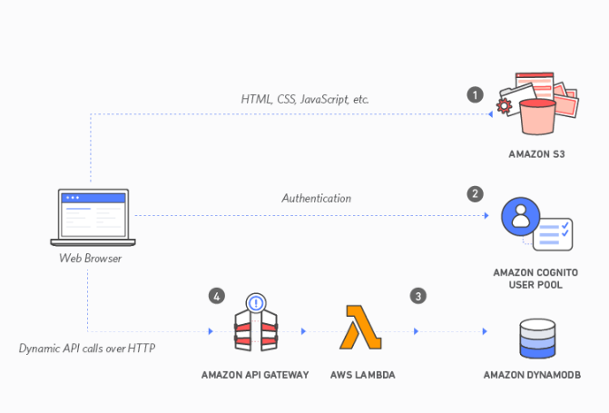
Cognito Use case – SSO with Implicit grant

Slide 10
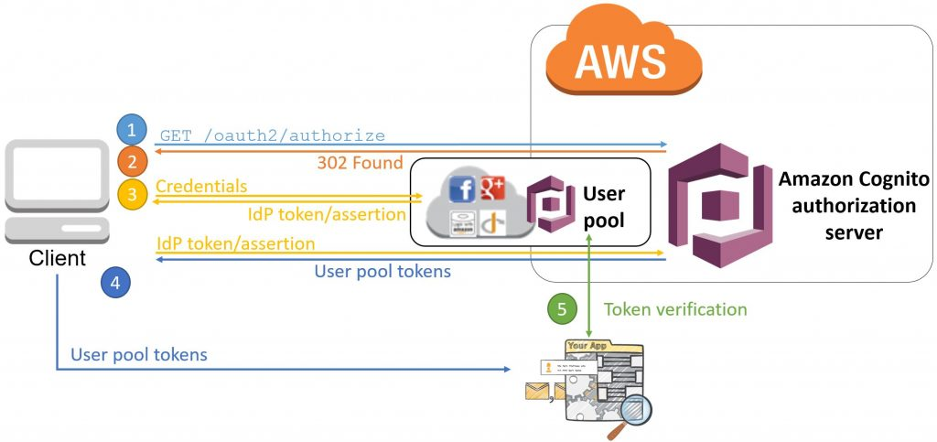
Cognito OAuth2 workflow with Implicit grant

Slide 11

Cognito Demo in AWS Console

Slide 12

Cognito .NET Code

